Slide 1
ASSIGNMENT Clustering & PCA
by:
Prajwal Rao

Slide 2

Business Objective
Business Objective
The aim of analysis is to identify and group countries by socio-economic and health factors to choose the countries that are in the direst need of aid.
Approach
problems are systematically solved using EDA ,data visualization and clustering.

Slide 3
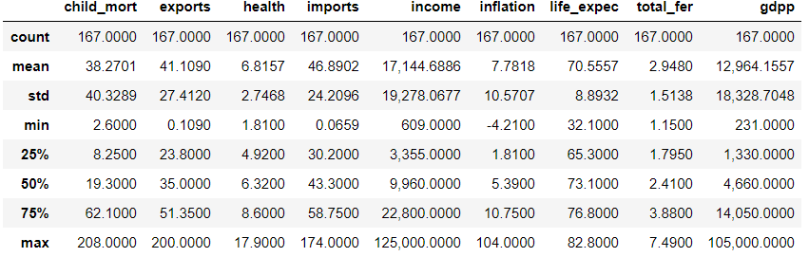
Data exploration
167 Countries
9 metrics (columns) available for socio-economic and health .
No null values in the dataset.
Convert inflation into absolute terms.

Slide 4
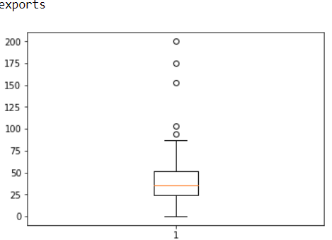
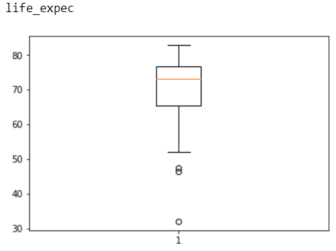
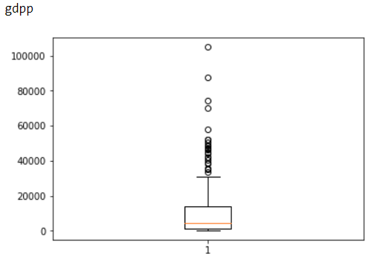
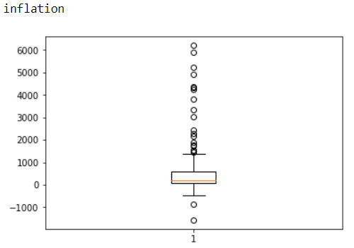
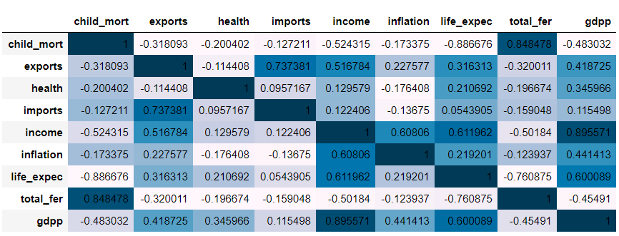
Data Analysis
Outlier Countries detected in the data set and must be removed before clustering
Few correlated columns detected and PCA analysis is don’t to create independent columns

Slide 5
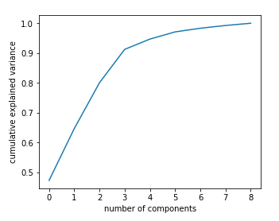
Principal Component Analysis
Performed standardization of data to perform PCA
Scree analysis shows 4 components are enough to describe 95% of the dataset and its variance.

Slide 6
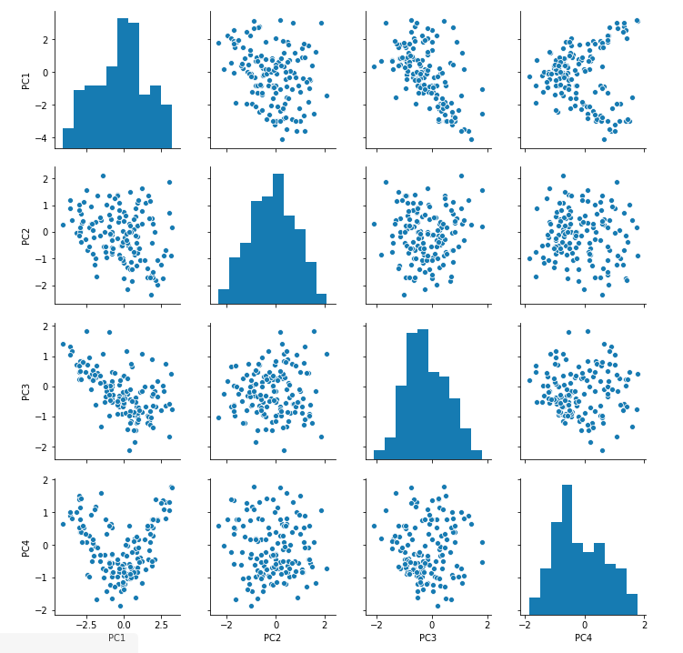
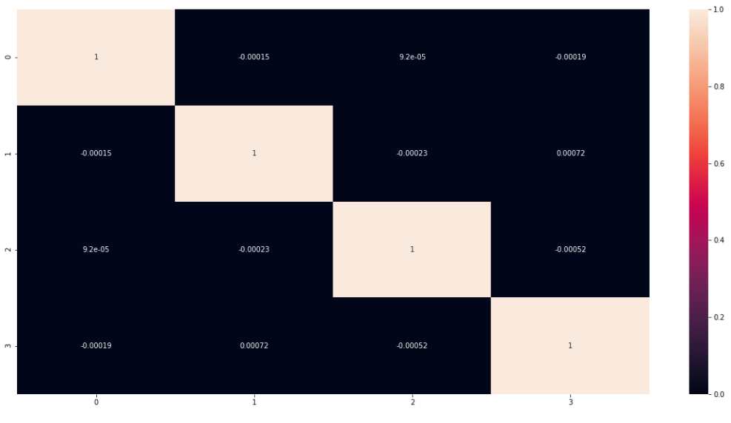
Analysis of PCA
PCA scatter plots
After removing outlier
PCA analysis results in independent columns

Slide 7
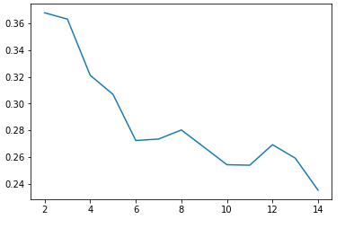
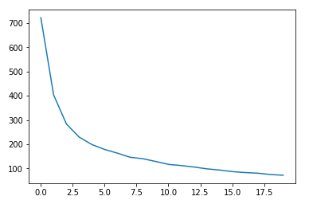
Cluster formation
Optimum number of cluster is found to be 4 by Silhouette Analysis and Elbow curve
3 cluster results in good clustering but 4 is chosen to target the countries with the most dire need of help

Slide 8
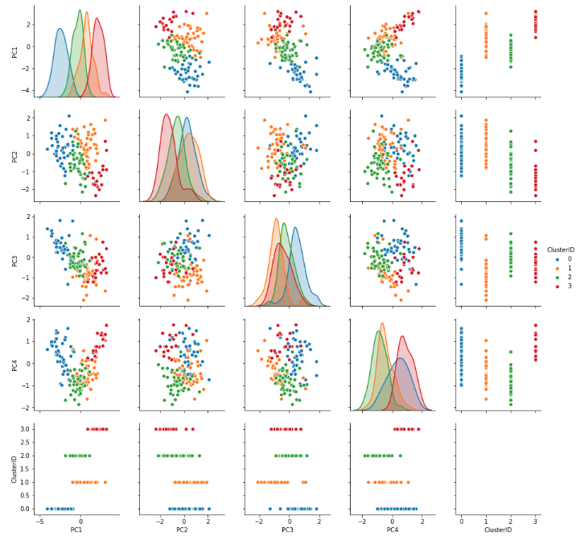
K-means
Optimum number of cluster is found to be 4 by Silhouette Analysis and Elbow curve

Slide 9
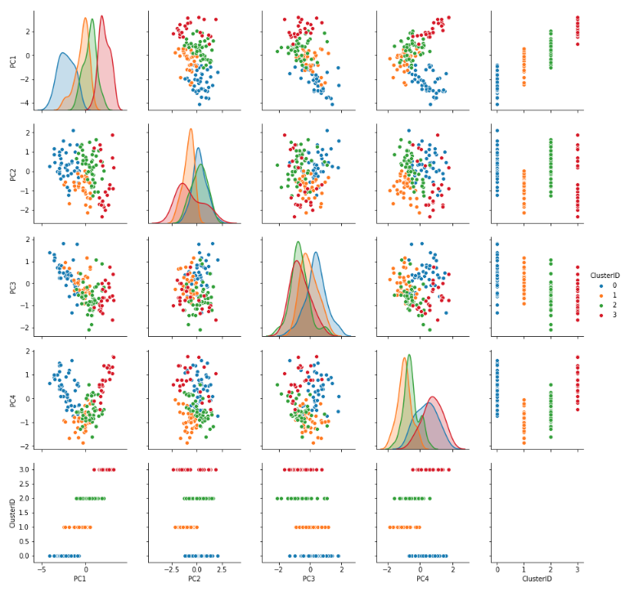
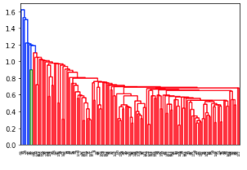
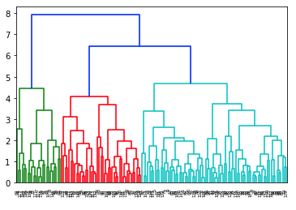
Hierarchical Clustering
Optimum number of cluster is found to be 4 by Silhouette Analysis and Elbow curve
K means and hierarchical clustering give same results

Slide 10
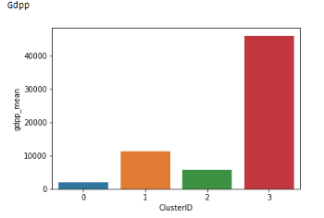
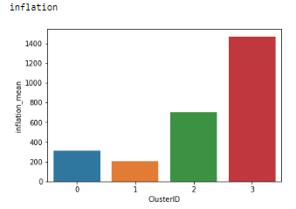
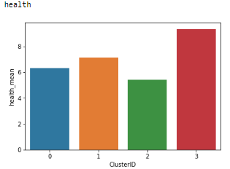
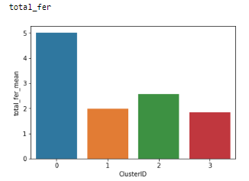
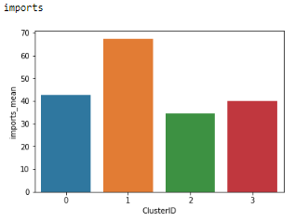
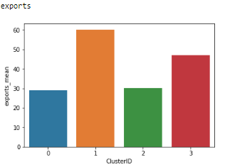
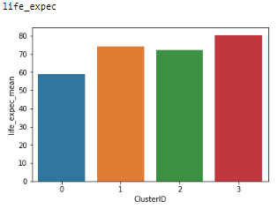
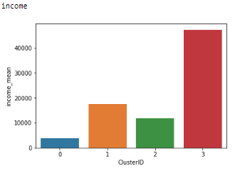
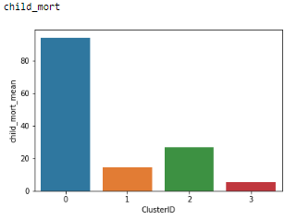
Analyzing Clusters
*actual cluster number will change on model rerun
Key Characteristics:
Cluster 0:
highest fertility ,child mortality.
Lowest income, gdpp, exports, life expectancy.
Very low inflation, health, imports.
The countries in this cluster are in need of dire need.
Cluster 1:
High health , imports , exports , income
Low inflation child mortalities
Cluster 2:
Countries rising from poverty
Mainly constitute the developing countries with India and china.
Cluster 3:
Highest health , and socio-economic factors
Developed countries

Slide 11
Conclusion
HELP International must invest in the following countries
countries that are in the direst need of aid are as follows:
Afghanistan | Lao | Gambia
Angola | Lesotho | Tanzania
Benin | Liberia | Timor-Leste
Botswana | Madagascar | Togo
BurkinaFaso | Malawi | Uganda
Burundi | Mali | Yemen
Cameroon | Mauritania | Zambia
CentralAfricanRepublic | Mozambique | Ghana
Chad | Namibia | Guinea
Comoros | Niger | Guinea-Bissau
Congo,Dem.Rep. | Nigeria | Haiti
Congo,Rep. | Pakistan | Kenya
Coted'Ivoire | Rwanda | Kiribati
EquatorialGuinea | Senegal | SouthAfrica
Eritrea | SierraLeone | Sudan
Gabon

